Slide 1

Mepco Schlenk Engineering College (Autonomous)
Personalized Deep Glucose Level Prediction for
Type-1 Diabetes Patients
GUIDED BY,
Dr.S.Amutha
Associate Professor,CSE
Muthukumarasamy S,21BCS171
Naren Karthikeyan M,21BCS172
Department of Computer Science and Engineering
1

Slide 2
Mepco Schlenk Engineering College (Autonomous)
Introduction
Accurate blood glucose (BG) prediction is crucial for managing type 1 diabetes (T1D) and preventing extreme glucose levels.
While traditional machine learning models effectively handle complex data, they lack interpretability.
Physiological white-box models simulate glucose-insulin dynamics and offer insights into BG fluctuations but are challenging to personalize and computationally intensive.
This research aims to develop a personalized BG prediction algorithm using a physiological white-box model and compare it with advanced black-box models to enhance T1D management tools and improve patient outcomes.
Department of Computer Science and Engineering
2

Slide 3
Mepco Schlenk Engineering College (Autonomous)
This research addresses the need for accurate blood glucose (BG) prediction models for type 1 diabetes (T1D).
Effective BG prediction is essential to prevent hyperglycemia and hypoglycemia, enhancing patient quality of life.
Current black-box models handle complex data well but lack interpretability, while physiological white-box models offer better insights but are hard to personalize and computationally intensive.
The goal is to find an optimal approach that combines the strengths of both model types for accurate, interpretable, and personalized BG predictions.
Problem Statement
Department of Computer Science and Engineering
3

Slide 4
Mepco Schlenk Engineering College (Autonomous)
Objectives
To develop a predictive model for glucose levels Prediction using deep learning techniques.
To design an algorithm for providing timely predictions to diabetes management.
To integrate a fuzzy algorithm for estimating the severity of blood glucose levels based on patient weight and glucose trends over time.
Department of Computer Science and Engineering
4

Slide 5
Mepco Schlenk Engineering College (Autonomous)
Outcomes
Outcome 1:
Predictive Model Development: Achieve a highly accurate and robust deep learning model for forecasting blood glucose levels, validated with patient data.
Outcome 2:
Designed an algorithm that collect and preprocess CGM data, insulin doses, and food intake for timely glucose predictions using a trained deep learning model.
Outcome 3:
Integrated fuzzy-based algorithm for estimating the severity of blood glucose levels by analyzing the patient's weight and glucose trends over time.
Department of Computer Science and Engineering
5

Slide 6
Mepco Schlenk Engineering College (Autonomous)
Literature Survey – Base Paper
Giacomo Cappon et al (2023) performed a study on,“Individualized Models for Glucose Prediction in Type 1 Diabetes: Comparing Black-Box Approaches to a Physiological White-Box One”, IEEE TRANSACTIONS ON BIOMEDICAL ENGINEERING, VOL. 70, NO. 11, NOVEMBER 2023.
Methodologies Adopted:
Black-box Approaches: Utilize machine learning techniques to model complex relationships without explicit physiological knowledge. They excel in capturing nonlinear patterns in data.
White-box Model: A structured physiological model that reflects biological processes, providing insights into glucose regulation mechanisms. It requires extensive parameter tuning, which can be complex.
Adaptive Strategies: The rARX model updates parameters based on new CGM data, enhancing prediction accuracy. This adaptability is crucial for real-time diabetes management.
Giacomo Cappon , Francesco Prendin , Andrea Facchinetti , Giovanni Sparacino and Simone Del Favero, “Individualized Models for Glucose Prediction in Type 1 Diabetes: Comparing Black-Box Approaches to a Physiological White-Box One”, IEEE TRANSACTIONS ON BIOMEDICAL ENGINEERING, VOL. 70, NO. 11, NOVEMBER 2023
Department of Computer Science and Engineering
6

Slide 7
Mepco Schlenk Engineering College (Autonomous)
Literature Survey - Base Paper Contd..
Merits:
High Prediction Accuracy: Black-box models often outperform traditional methods, effectively learning from large datasets
Physiological Insight: White-box models offer valuable insights into glucose regulation, understanding patient-specific responses
Adaptability: Adaptive strategies allow real-time updates, making them responsive to changes in a patient's condition .
Demerits:
Lack of Interpretability: Black-box models can be difficult to interpret, hindering clinician trust in predictions
Complexity of White-box Models: These models can be resource-intensive and require extensive tuning, which may be time-consuming
Data Dependency: Adaptive strategies depend on the quality of CGM data; poor data can lead to inaccurate predictions.
Giacomo Cappon , Francesco Prendin , Andrea Facchinetti , Giovanni Sparacino and Simone Del Favero, “Individualized Models for Glucose Prediction in Type 1 Diabetes: Comparing Black-Box Approaches to a Physiological White-Box One”, IEEE TRANSACTIONS ON BIOMEDICAL ENGINEERING, VOL. 70, NO. 11, NOVEMBER 2023
Department of Computer Science and Engineering
7

Slide 8
Mepco Schlenk Engineering College (Autonomous)
Literature Survey - 1
Cindy Marling1 & Razvan Bunescu1 (2020) performed a study on “The OhioT1DM Dataset for Blood Glucose Level Prediction Update 2020”
Methodologies Used:
Data Collection: Continuous glucose monitoring and insulin data from 12 individuals with type 1 diabetes over 8 weeks.
Physiological Monitoring: Participants wore fitness bands for heart rate and activity data.
Self-Reported Data: Life events affecting glucose levels were recorded via a smartphone app.
Merits:
Comprehensive:
1)Combines various data types for better analysis.
Cindy Marling1, Razvan Bunescu1, “The OhioT1DM Dataset for Blood Glucose Level Prediction Update 2020”, EUR Workshop Proc. 2020 September ; 2675: 71–74
Department of Computer Science and Engineering
8

Slide 9
Mepco Schlenk Engineering College (Autonomous)
Literature Survey – 1 Contd..
Longitudinal:
1)8-week duration allows for trend observation
Demerits:
Small Sample Size:
1)Limits generalizability.
Data Gaps:
2)Missing overnight data from some participants.
Cindy Marling1, Razvan Bunescu1, “The OhioT1DM Dataset for Blood Glucose Level Prediction Update 2020”, EUR Workshop Proc. 2020 September ; 2675: 71–74
Department of Computer Science and Engineering
9

Slide 10
Mepco Schlenk Engineering College (Autonomous)
Literature Survey - 2
Mario Munoz-Organero (2021) performed a study on “Deep Physiological Model for Blood Glucose Prediction in T1DM Patients”
Methodologies Adopted:
Developed a deep learning model that incorporates physiological data to predict blood glucose levels in Type 1 diabetes (T1DM) patients.
Utilized deep neural networks to model complex physiological interactions affecting glucose levels.
Merits:
Leverages deep learning to capture complex physiological interactions for accurate glucose prediction.
Mario Munoz-Organero, “Deep physiological model for blood glucose prediction in T1DM patients”, Sensors 2020, 20,3896.
Department of Computer Science and Engineering
10

Slide 11
Mepco Schlenk Engineering College (Autonomous)
Literature Survey – 2 Contd..
Provides insights into physiological factors affecting blood glucose levels.
Improves prediction accuracy for T1DM patients through advanced modeling techniques.
Demerits:
Requires extensive and high-quality physiological data for effective training.
Deep learning models can be computationally intensive and complex.
May face challenges in generalizing across diverse patient populations.
Mario Munoz-Organero, “Deep physiological model for blood glucose prediction in T1DM patients”, Sensors 2020, 20,3896.
Department of Computer Science and Engineering
11

Slide 12
Mepco Schlenk Engineering College (Autonomous)
Literature Survey - 3
Ganjar Alfian et al. (2021) performed a study on “Blood glucose prediction model for type 1 diabetes based on artificial neural network with time-domain features”
Methodologies Adopted:
Data Collection: Real-world blood glucose data from type 1 diabetes patients.
Feature Extraction: Time-domain features such as glucose trends and patterns over time were extracted.
Model Development: Artificial Neural Network (ANN) was used to develop the prediction model.
Evaluation: Performance metrics included Mean Absolute Error (MAE) and Root Mean Squared Error (RMSE).
Ganjar Alfian, Muhammad Syafrudin, Muhammad Anshari, Filip Benes, Fransiskus Tatas Dwi Atmaji, Imam Fahrurrozi, Ahmad Fathan Hidayatullah, Jongtae Rhee, “Blood glucose prediction model for type 1 diabetes based on artificial neural network with time-domain features”, Journal of Biomedical Informatics, 109 (2021) 103538.
Department of Computer Science and Engineering
12

Slide 13
Mepco Schlenk Engineering College (Autonomous)
Literature Survey- 3 Contd..
Merits:
Utilizes time-domain features for improved prediction accuracy.
Effective in capturing glucose trends and patterns over time.
ANN model demonstrates robust performance in predictions.
Demerits:
Requires continuous and high-quality data for training.
ANN models can be complex and resource-intensive.
Model may not account for all variability in individual glucose responses.
Ganjar Alfian, Muhammad Syafrudin, Muhammad Anshari, Filip Benes, Fransiskus Tatas Dwi Atmaji, Imam Fahrurrozi, Ahmad Fathan Hidayatullah, Jongtae Rhee, “Blood glucose prediction model for type 1 diabetes based on artificial neural network with time-domain features”, Journal of Biomedical Informatics, 109 (2021) 103538.
Department of Computer Science and Engineering
13

Slide 14
Mepco Schlenk Engineering College (Autonomous)
Literature Survey - 4
Jobeda Jamal Khanam & Simon Y. Foo (2021) conducted a study on "A comparison of machine learning algorithms for diabetes prediction“
Methodologies Adopted:
Compared various machine learning algorithms for predicting diabetes.
Evaluated the performance of each algorithm using standard metrics like accuracy, precision, and recall.
Merits:
Provides a comprehensive comparison of different machine learning algorithms for diabetes prediction.
Helps identify the most effective algorithm based on performance metrics.
Offers insights into the strengths and weaknesses of various predictive models.
Jobeda Jamal Khanam, Simon Y. Foo, “A comparison of machine learning algorithms for diabetes prediction”, ICT Express 7 (2021) 432-439.
Department of Computer Science and Engineering
14

Slide 15
Mepco Schlenk Engineering College (Autonomous)
Literature Survey – 4 Contd..
Demerits:
Performance may vary depending on the quality and characteristics of the dataset used.
The study may not account for algorithm-specific tuning and optimization processes.
Requires substantial computational resources for evaluating multiple algorithms.
Jobeda Jamal Khanam, Simon Y. Foo, “A comparison of machine learning algorithms for diabetes prediction”, ICT Express 7 (2021) 432-439.
Department of Computer Science and Engineering
15

Slide 16
Mepco Schlenk Engineering College (Autonomous)
Literature Survey - 5
Wonju Seoa et al. (2021) performed a study on “A personalized blood glucose level prediction model with a fine-tuning strategy: A proof-of-concept study”
Methodologies Adopted:
Data Collection: Real-world CGM data, contextual info (meal intake, physical activity, insulin dosage).
Model Development: Initial training on a generic dataset using regression models and neural networks.
Fine-Tuning Strategy: Transfer learning for personalization, custom loss function for glucose response variability.
Evaluation: Metrics (MAE, RMSE), comparative analysis with baseline models.
Wonju Seoa, Sung-Woon Park, Namho Kima, Sang-Man Jinc, Sung-Min Parka, “A personalized blood glucose level prediction model with a fine-tuning strategy: A proof-of-concept study”, Computer Methods and Programs in Biomedicine, 211 (2021) 106424.
Department of Computer Science and Engineering
16

Slide 17
Mepco Schlenk Engineering College (Autonomous)
Literature Survey - 5 Contd..
Merits:
Improved prediction accuracy through personalized fine-tuning.
Tailored to individual patient data.
Incorporates meal intake, physical activity, and insulin dosage for more relevant predictions.
Demerits:
Needs extensive and continuous data collection from patients.
Advanced machine learning techniques increase model complexity.
May not perform well without sufficient patient-specific data
Wonju Seoa, Sung-Woon Park, Namho Kima, Sang-Man Jinc, Sung-Min Parka, “A personalized blood glucose level prediction model with a fine-tuning strategy: A proof-of-concept study”, Computer Methods and Programs in Biomedicine, 211 (2021) 106424.
Department of Computer Science and Engineering
17

Slide 18
Mepco Schlenk Engineering College (Autonomous)
Literature Survey - 6
Hatice Vildan Dudukcu et al. (2021) performed a study on "Blood glucose prediction with deep neural networks using weighted decision level fusion“
Methodologies Adopted:
Utilized deep neural networks combined with weighted decision level fusion to predict blood glucose levels.
Integrated multiple prediction models and applied fusion techniques to improve accuracy and robustness.
Merits:
Enhances prediction accuracy by combining multiple models through weighted decision level fusion.
Hatice Vildan Dudukcu, Murat Taskiran, Tulay Yildirim, “Blood glucose prediction with deep neural networks using weighted decision level fusion”, biocybernetics and biomedical engineering 41 (2021) 1208– 1223
Department of Computer Science and Engineering
18

Slide 19
Mepco Schlenk Engineering College (Autonomous)
Literature Survey – 6 Contd..
Deep neural networks capture complex patterns in glucose data effectively.
Improves robustness and reliability of predictions.
Demerits:
Requires significant computational resources for training and fusion processes.
Complexity of the model may make it difficult to interpret and fine-tune.
Performance heavily depends on the quality of input data and fusion weights.
Hatice Vildan Dudukcu, Murat Taskiran, Tulay Yildirim, “Blood glucose prediction with deep neural networks using weighted decision level fusion”, biocybernetics and biomedical engineering 41 (2021) 1208– 1223
Department of Computer Science and Engineering
19

Slide 20
Mepco Schlenk Engineering College (Autonomous)
Literature Survey - 7
Shahid Mohammad Ganie & Majid Bashir Malik (2021) performed a study on “An ensemble Machine Learning approach for predicting Type-I diabetes mellitus based on lifestyle indicators”
Methodologies Adopted:
Applied an ensemble machine learning approach to predict Type-I diabetes using lifestyle indicators (e.g., diet, physical activity).
Combined multiple machine learning models to improve prediction accuracy and robustness.
Merits:
Utilizes an ensemble approach to enhance prediction accuracy and reduce overfitting.
Shahid Mohammad Ganie, Majid Bashir Malik, “An ensemble machine learning approach for predicting Type-I diabetes mellitus based on lifestyle indicators”, Health Care Analysis 2 (2022) 100092.
Department of Computer Science and Engineering
20

Slide 21
Mepco Schlenk Engineering College (Autonomous)
Literature Survey – 7 Contd..
Incorporates lifestyle indicators, which are crucial for predicting Type-I diabetes.
Provides a more robust and reliable prediction model.
Demerits:
Requires integration and tuning of multiple models, which can be complex and resource-intensive.
Performance may vary based on the quality and relevance of lifestyle data.
May require extensive preprocessing and feature selection.
Shahid Mohammad Ganie, Majid Bashir Malik, “An ensemble machine learning approach for predicting Type-I diabetes mellitus based on lifestyle indicators”, Health Care Analysis 2 (2022) 100092.
Department of Computer Science and Engineering
21

Slide 22
Mepco Schlenk Engineering College (Autonomous)
Literature Survey - 8
Guanci Yang et al. (2021) performed a study on "Short-term prediction method of blood glucose based on temporal multi-head attention mechanism for diabetic patients“
Methodologies Adopted:
Implemented a temporal multi-head attention mechanism to predict short-term blood glucose levels.
Utilized historical glucose data and attention mechanisms to enhance prediction accuracy.
Merits:
Leverages advanced attention mechanisms for improved prediction accuracy.
Guanci Yang, Saisai Liu, Yang Li, Ling He, “Short-term prediction method of blood glucose based on temporal multi-head attention mechanism for diabetic patients”, Biomedical Signal Processing and Control 82 (2023) 104552.
Department of Computer Science and Engineering
22

Slide 23
Mepco Schlenk Engineering College (Autonomous)
Literature Survey – 8 Contd..
Focuses on short-term glucose level predictions, which is crucial for timely diabetes management.
Captures temporal dependencies in glucose data effectively.
Demerits:
Requires extensive historical data to train the model effectively.
The complexity of the attention mechanism may increase computational demands.
Performance may vary with different types of glucose monitoring devices.
Guanci Yang, Saisai Liu, Yang Li, Ling He, “Short-term prediction method of blood glucose based on temporal multi-head attention mechanism for diabetic patients”, Biomedical Signal Processing and Control 82 (2023) 104552.
Department of Computer Science and Engineering
23

Slide 24
Mepco Schlenk Engineering College (Autonomous)
Literature Survey - 9
Gangani Dharmarathne et al. (2021) performed a study on “A novel machine learning approach for diagnosing diabetes with a self-explainable interface”
Methodologies Adopted:
Developed a machine learning model for diabetes diagnosis with a focus on interpretability.
Implemented a self-explainable interface to provide transparent and understandable predictions.
Merits:
Enhances transparency and interpretability of the machine learning model.
Gangani Dharmarathne, Thilini N. Jayasinghe, Madhusha Bogahawaththa, D.P.P. Meddage, Upaka Rathnayake, “A novel machine learning approach for diagnosing diabetes with a self-explainable interface”, Healthcare Analysis, (2024) 100301.
Department of Computer Science and Engineering
24

Slide 25
Mepco Schlenk Engineering College (Autonomous)
Literature Survey - 9 Contd..
Provides clear explanations of diagnosis decisions, aiding user trust and understanding.
Potentially improves diagnostic accuracy with advanced machine learning techniques.
Demerits:
Model complexity might impact the ease of explanation and interface usability.
Requires substantial computational resources for developing and maintaining the self-explainable interface.
May be limited by the quality and representativeness of the training data.
Gangani Dharmarathne, Thilini N. Jayasinghe, Madhusha Bogahawaththa, D.P.P. Meddage, Upaka Rathnayake, “A novel machine learning approach for diagnosing diabetes with a self-explainable interface”, Healthcare Analysis, (2024) 100301
Department of Computer Science and Engineering
25

Slide 26
Mepco Schlenk Engineering College (Autonomous)
Literature Survey - 10
Sean Pikulin et al. (2021) performed a study on “Enhanced blood glucose levels prediction with a smartwatch”
Methodologies Adopted:
Used smartwatch sensors to collect physiological data.
Developed a predictive model to estimate blood glucose levels based on smartwatch data.
Merits:
Integrates wearable technology for continuous glucose monitoring.
Provides real-time glucose predictions based on physiological data.
Non-invasive and convenient for users.
Sean Pikulin, Irad Yehezkel, Robert Moskovitch, “Enhanced blood glucose levels prediction with a smartwatch”, PLoS ONE 19(7) (2024)
Department of Computer Science and Engineering
26

Slide 27
Mepco Schlenk Engineering College (Autonomous)
Literature Survey – 10 Contd..
Demerits:
Accuracy may depend on the quality and type of data collected by the smartwatch.
Limited by the smartwatch’s sensor capabilities and data granularity.
Potential issues with data privacy and security.
Sean Pikulin, Irad Yehezkel, Robert Moskovitch, “Enhanced blood glucose levels prediction with a smartwatch”, PLoS ONE 19(7) (2024)
Department of Computer Science and Engineering
27

Slide 28
Mepco Schlenk Engineering College (Autonomous)
Literature Survey
Consolidation of the literatures:
S.No. | Author(s) & Year | Methodology used | Limitations
1 | Cindy Marling, Razvan Bunescu (2020) | OhioT1DM dataset for blood glucose level prediction | Limited by the scope and specifics of the dataset, which may not represent broader population diversity.
2 | Mario Munoz-Organero (2020) | Deep physiological model has been used. | The model may not generalize well to all patients due to individual physiological differences.
Department of Computer Science and Engineering
28

Slide 29
Mepco Schlenk Engineering College (Autonomous)
Literature Survey
Consolidation of the literatures:
S.No. | Author(s) & Year | Methodology used | Limitations
3 | Ganjar Alfian, Muhammad Syafrudin, Muhammad Anshari (2020) | Artificial neural network with time-domain features | Limited by the dataset size and diversity, which may affect the model’s robustness and generalizability.
4 | Jobeda Jamal Khanam, Simon Y. Foo (2021) | Comparison of machine learning algorithms | Performance may vary depending on the dataset used; does not identify the best algorithm universally applicable.
Department of Computer Science and Engineering
29

Slide 30
Mepco Schlenk Engineering College (Autonomous)
Literature Survey
Consolidation of the literatures:
S.No. | Author(s) & Year | Methodology used | Limitations
5 | Wonju Seo, Sung-Woon Park, Namho Kim, Sang-Man Jin, Sung-Min Park (2021) | Personalized blood glucose level prediction model with a fine-tuning strategy | Fine-tuning strategy may be computationally intensive and time-consuming.
6 | Hatice Vildan Dudukcu, Murat Taskiran, Tulay Yildirim (2021) | Deep neural networks using weighted decision level fusion | High computational requirements and potential overfitting due to the complexity of the model.
Department of Computer Science and Engineering
30

Slide 31
Mepco Schlenk Engineering College (Autonomous)
Literature Survey
Consolidation of the literatures:
S.No. | Author(s) & Year | Methodology used | Limitations
7 | Shahid Mohammad Ganie & Majid Bashir Malik (2022) | Ensemble machine learning approach based on lifestyle indicators | May not account for all lifestyle variables affecting diabetes, leading to incomplete predictions.
8 | Guanci Yang, Saisai Liu, Yang Li, Ling He (2023) | Short-term prediction using temporal multi-head attention mechanism | May require significant computational resources and may not be suitable for long-term predictions.
Department of Computer Science and Engineering
31

Slide 32
Mepco Schlenk Engineering College (Autonomous)
Literature Survey
Consolidation of the literatures:
S.No. | Author(s) & Year | Methodology used | Limitations
9 | Gangani Dharmarathne, Thilini N. Jayasinghe, Madhusha Bogahawaththa, D.P.P. Meddage, Upaka Rathnayake (2024) | Machine learning approach with a self-explainable interface | Self-explainable interface might complicate the model, potentially reducing prediction accuracy.
10 | Sean Pikulin, Irad Yehezkel, Robert Moskovitch (2024) | Enhanced blood glucose levels prediction with a smartwatch | Reliant on smartwatch sensor accuracy and consistency, which can vary and impact the model’s predictions.
Department of Computer Science and Engineering
32

Slide 33
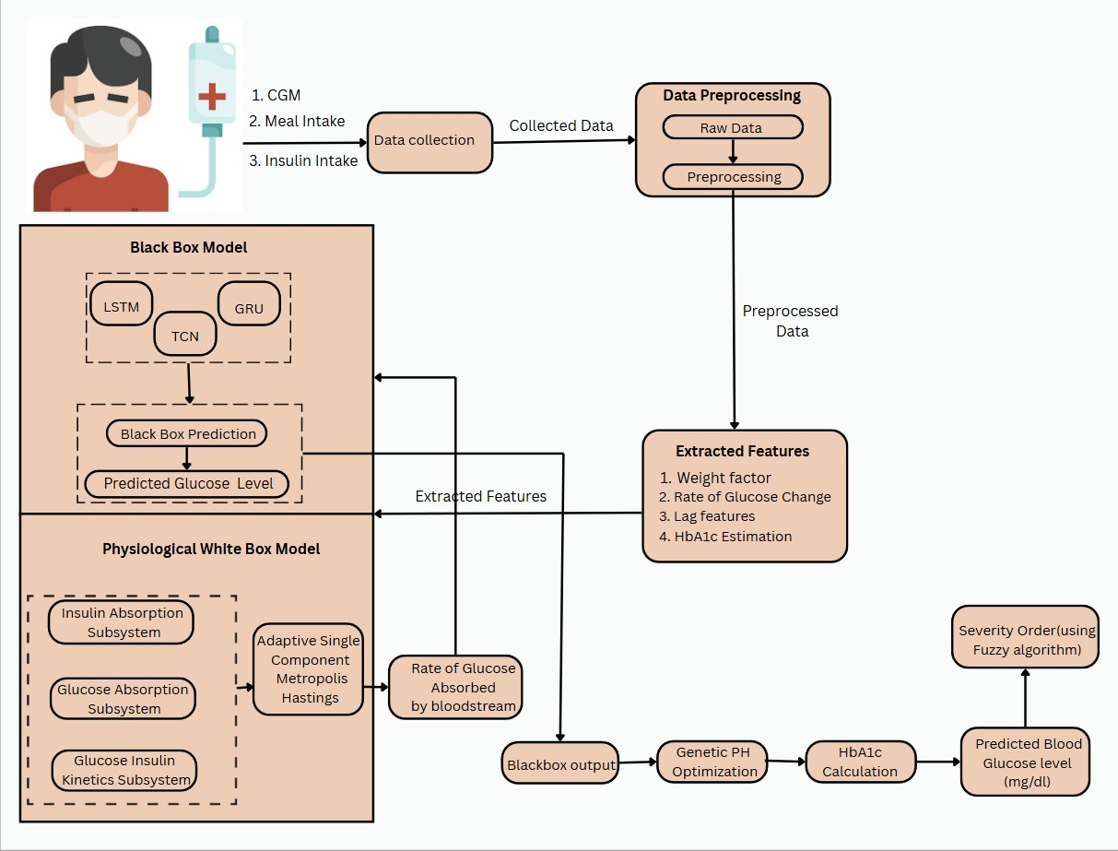
Mepco Schlenk Engineering College (Autonomous)
System Design of the Proposed Layered Approach
Department of Computer Science and Engineering
33

Slide 34
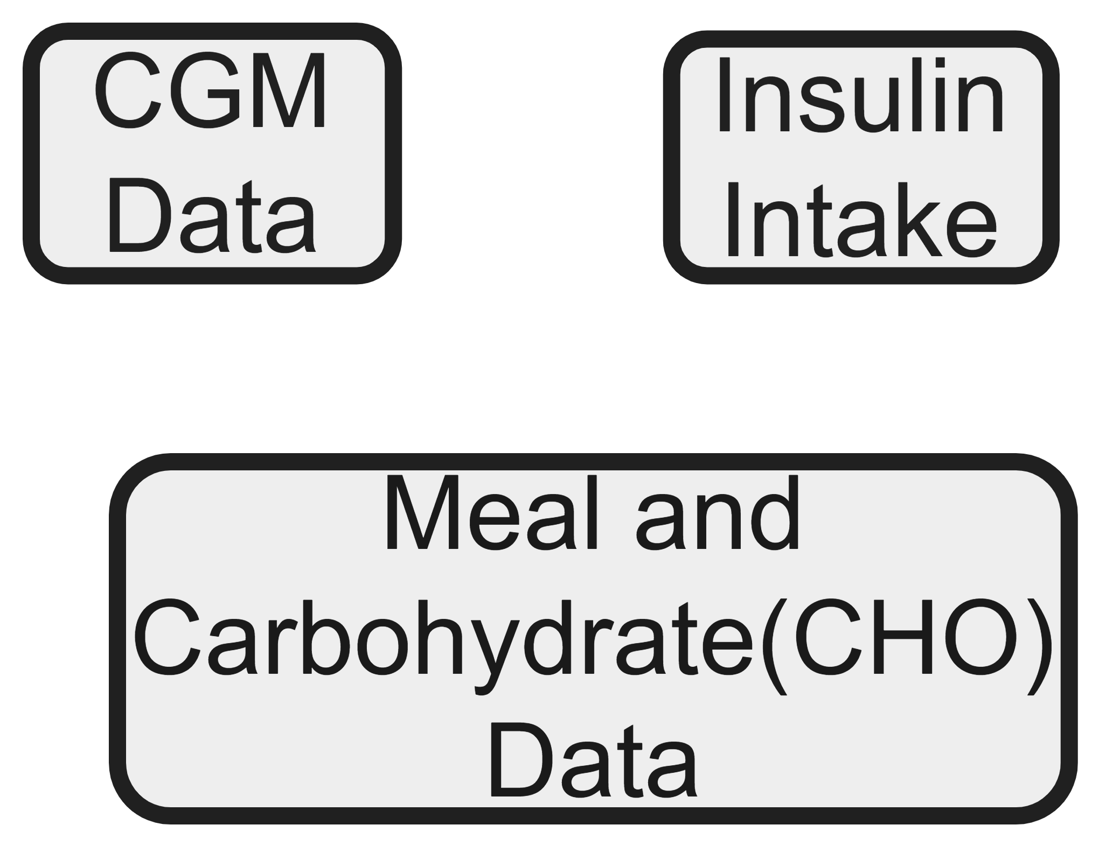
Mepco Schlenk Engineering College (Autonomous)
System Design of the Proposed Layered Approach
Data Collection
Department of Computer Science and Engineering
34

Slide 35
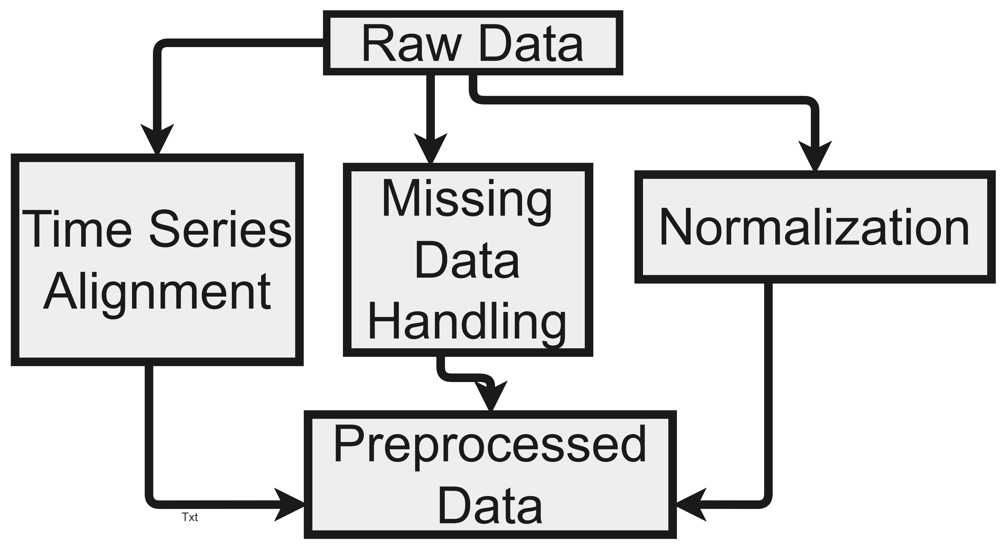
Mepco Schlenk Engineering College (Autonomous)
System Design of the Proposed Layered Approach
Data Preprocessing
Department of Computer Science and Engineering
35

Slide 36
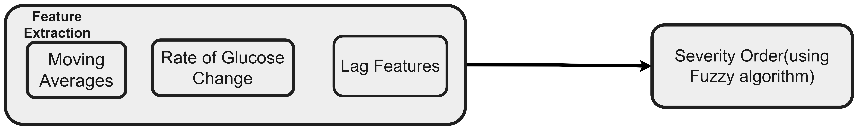
Mepco Schlenk Engineering College (Autonomous)
System Design of the Proposed Layered Approach
Feature Extraction and Predicting Severity order using Fuzzy logic
Department of Computer Science and Engineering
36

Slide 37
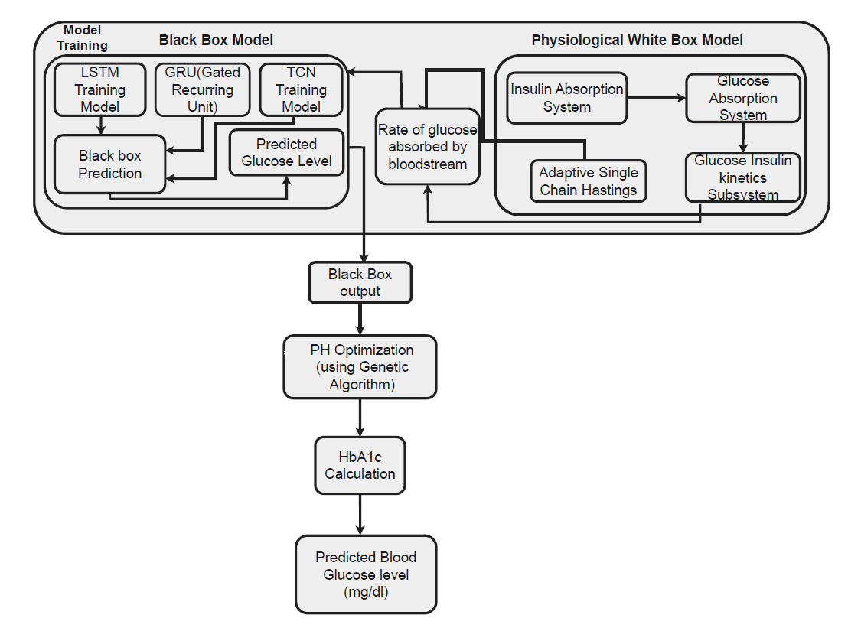
Mepco Schlenk Engineering College (Autonomous)
System Design of the Proposed Layered Approach
HYBRID APPROACH –Passing the White box prediction as an additional input for black box model
Department of Computer Science and Engineering
37

Slide 38
Mepco Schlenk Engineering College (Autonomous)
Problem Definition and Description of Model
The primary challenge addressed in this research is the accurate prediction of blood glucose (BG) levels in individuals with Type 1 Diabetes (T1D).
Effective glucose control is vital to prevent hypoglycemia, hyperglycemia, and severe health complications.
Traditional models struggle to adapt to glucose metabolism's variability, influenced by meals, insulin, and individual responses.
Compares a physiologically-based white-box model with black-box machine learning models to improve prediction accuracy and adaptability..
Department of Computer Science and Engineering
38

Slide 39
Mepco Schlenk Engineering College (Autonomous)
Problem Definition and Description of Model
1. Data Input Module
Description: This module is essential for gathering and preprocessing the data necessary for glucose prediction. It includes:
Continuous Glucose Monitoring (CGM) Data: Real-time BG levels collected from CGM devices.
Nutritional Information: Data on carbohydrate intake, including meal timing and composition.
Insulin Administration Records: Details about the type and dosage of insulin administered.
Techniques: Data is normalized and formatted as time-series to ensure compatibility with prediction algorithms, enhancing input quality and reliability.
Department of Computer Science and Engineering
39

Slide 40
Mepco Schlenk Engineering College (Autonomous)
Problem Definition and Description of Model
White-Box Model Module
Description:
This module implements a nonlinear physiological model simulating glucose-insulin dynamics as a benchmark for comparison against black-box models.
Techniques:
The model uses physiological equations to describe glucose-insulin interactions, incorporating insulin absorption and glucose kinetics for interpretable, biologically-based predictions.
Department of Computer Science and Engineering
40

Slide 41
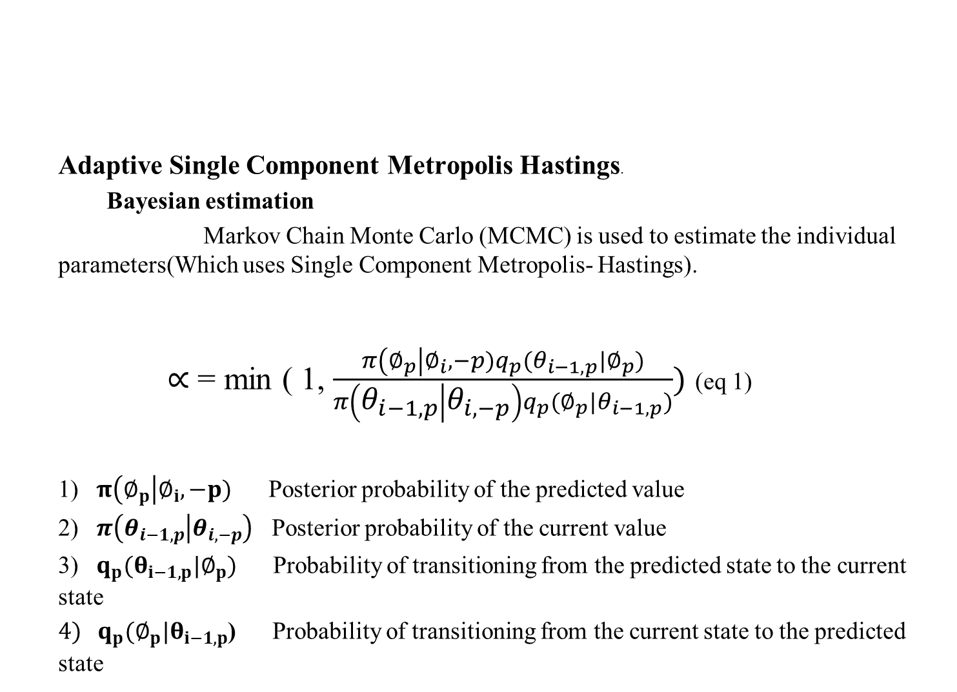
Mepco Schlenk Engineering College (Autonomous)
Adaptive Single Component Metropolis Hastings.
Bayesian estimation
Markov Chain Monte Carlo (MCMC) is used to estimate the individual parameters(Which uses Single Component Metropolis- Hastings).
$∝$ = min ( 1, $\frac{π\left(∅_{p}\right|∅_{i},−p)q_{p}(θ_{i−1,p}|∅_{p})}{π\left(θ_{i−1,p} | θ_{i,−p}\right)q_{p}(∅_{p}|θ_{i−1,p})})$ (eq 1)
1) $π\left(∅_{p}\right|∅_{i},−p)$ Posterior probability of the predicted value
2) $π\left(θ_{i−1,p} | θ_{i,−p}\right)$ Posterior probability of the current value
3) $q_{p}(θ_{i−1,p}|∅_{p})$ Probability of transitioning from the predicted state to the current state
$4) q_{p}(∅_{p}|θ_{i−1,p}$) Probability of transitioning from the current state to the predicted state
Problem Definition and Description of Model
Department of Computer Science and Engineering
41

Slide 42
Mepco Schlenk Engineering College (Autonomous)
Problem Definition and Description of Model
Glucose Insulin Dynamics
Insulin Absorption Subsystem:
Description: Tracks subcutaneous insulin absorption, accounting for injected insulin entering the bloodstream..
Techniques: Utilizes compartments for insulin states (non-monomeric and monomeric) and equations for diffusion and absorption to predict plasma insulin levels.
Department of Computer Science and Engineering
42

Slide 43
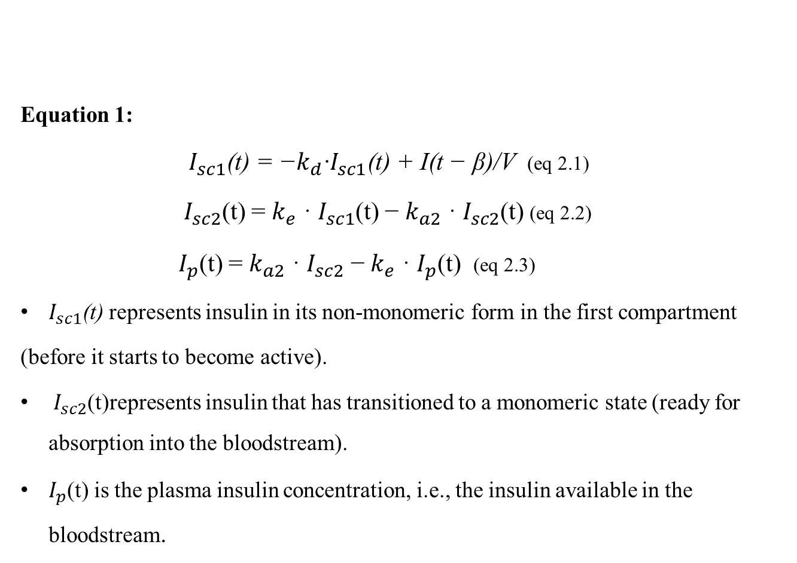
Mepco Schlenk Engineering College (Autonomous)
Problem Definition and Description of Model
Equation 1:
$I_{sc1}\text{(}\text{t}\text{) = −}k_{d}\text{·}I_{sc1}\text{(}\text{t}\text{) + }\text{I}\text{(}\text{t}\text{ − }\text{β}\text{)/}\text{V}$(eq 2.1)
${ I}_{sc2}$(t) = $k_{e}$ · $I_{sc1}$(t) − $k_{a2}$ · $I_{sc2}$(t) (eq 2.2)
${ I}_{p}$(t) = $k_{a2}$ · $I_{sc2}$ − $k_{e}$ · $I_{p}$(t) (eq 2.3)
$I_{sc1}\text{(}\text{t}\text{) }$represents insulin in its non-monomeric form in the first compartment
(before it starts to become active).
${ I}_{sc2}$(t)represents insulin that has transitioned to a monomeric state (ready for absorption into the bloodstream).
$I_{p}$(t) is the plasma insulin concentration, i.e., the insulin available in the bloodstream.
Department of Computer Science and Engineering
43

Slide 44

Mepco Schlenk Engineering College (Autonomous)
Problem Definition and Description of Model
$k_{d}$is the rate at which insulin transforms from a non-monomeric state to a monomeric state.
$k_{a2}$ ​ is the absorption rate from the monomeric form into the plasma.
$k_{e}$ is the clearance rate, indicating how quickly insulin is removed from the plasma.
V is the volume of insulin distribution in the body.
$\text{I}\text{(}\text{t}\text{ − }\text{β}\text{)}$represents the insulin injected at time $\text{(}\text{t}\text{ − }\text{β}\text{)}$, with a delay 𝛽 accounting for the time it takes for insulin to appear in the body after being injected.
Department of Computer Science and Engineering
44

Slide 45

Mepco Schlenk Engineering College (Autonomous)
Problem Definition and Description of Model
2.Oral Glucose Absorption Subsystem:
Description: Models carbohydrate absorption in the gastrointestinal system and conversion into glucose in the bloodstream
Techniques: Describes glucose absorption in a three-compartment system (stomach, intestine) with parameters for gastric emptying and intestinal absorption, using differential equations.
Equation 2:
${ Q}_{sto1}(t) = −k_{gri}·Q_{sto1}(t) + CHO(t)$ (eq 3.1)
${ Q}_{sto2}(t) =k_{gri}·Q_{sto1}(t) −k_{empt}·Q_{sto2}(t)$ (eq 3.2)
${ Q}_{gut}(t) =k_{empt}·Q_{sto2}(t) −k_{abs}·Q_{gut}(t)$ (eq 3.3)
$R_{a}(t) = f ·k_{abs}·Q_{gut}(t)$ (eq 3.4)
Department of Computer Science and Engineering
45

Slide 46
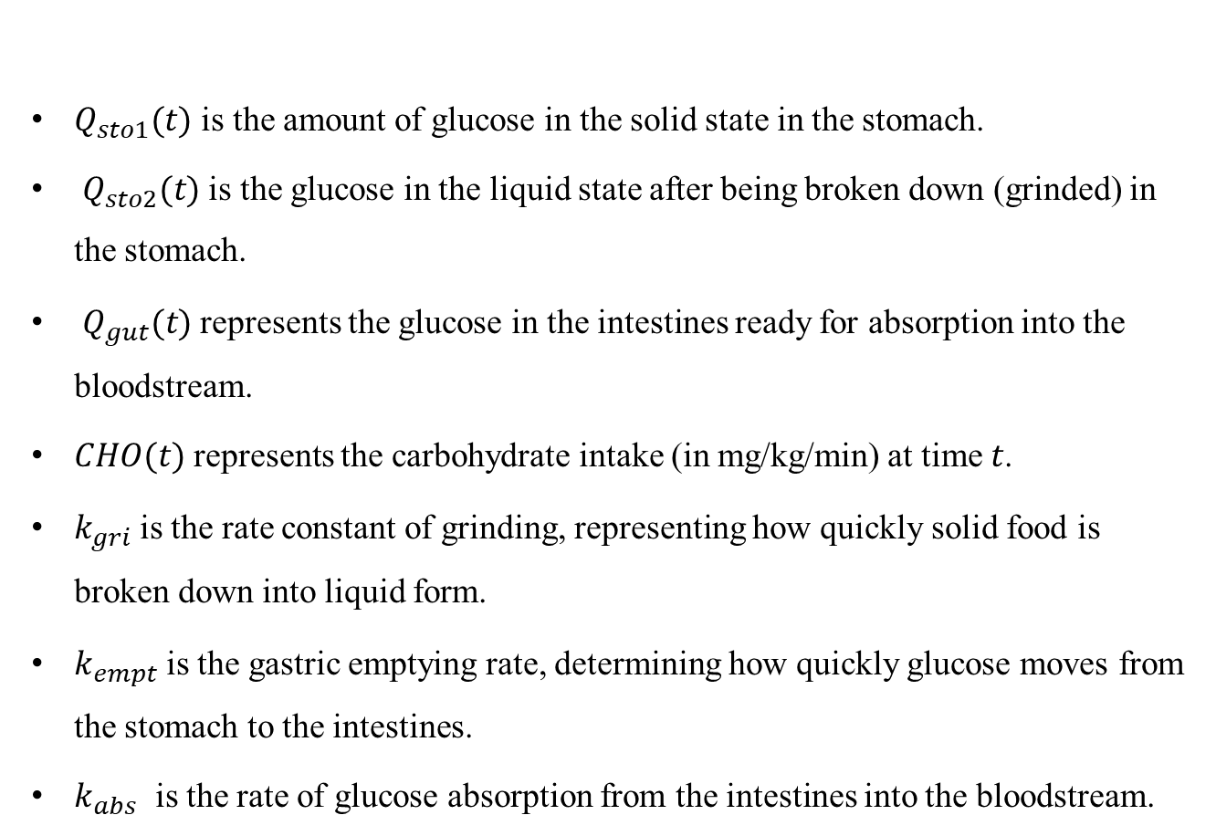
Mepco Schlenk Engineering College (Autonomous)
Problem Definition and Description of Model
$Q_{sto1}(t)$ is the amount of glucose in the solid state in the stomach.
$Q_{sto2}(t)$is the glucose in the liquid state after being broken down (grinded) in the stomach.
$Q_{gut}(t)$represents the glucose in the intestines ready for absorption into the bloodstream.
$CHO(t)$represents the carbohydrate intake (in mg/kg/min) at time 𝑡.
$k_{gri}$is the rate constant of grinding, representing how quickly solid food is broken down into liquid form.
​$k_{empt}$is the gastric emptying rate, determining how quickly glucose moves from the stomach to the intestines.
$k_{abs}$​ is the rate of glucose absorption from the intestines into the bloodstream.
Department of Computer Science and Engineering
46

Slide 47
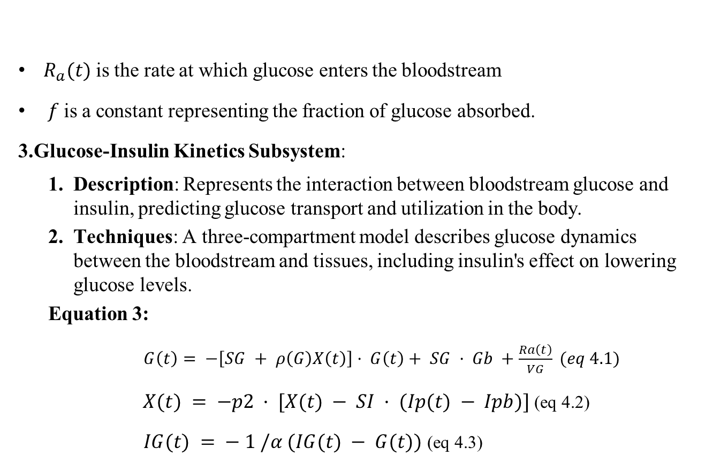
Mepco Schlenk Engineering College (Autonomous)
Problem Definition and Description of Model
$R_{a}(t)$is the rate at which glucose enters the bloodstream
$f$is a constant representing the fraction of glucose absorbed.
3.Glucose-Insulin Kinetics Subsystem:
Description: Represents the interaction between bloodstream glucose and insulin, predicting glucose transport and utilization in the body.
Techniques: A three-compartment model describes glucose dynamics between the bloodstream and tissues, including insulin's effect on lowering glucose levels.
Equation 3:
$G\left(t\right)= −\left[SG + ρ\left(G\right)X\left(t\right)\right]· G\left(t\right)+ SG · Gb +\frac{Ra\left(t\right)}{VG} (eq 4.1)$
$X(t) = −p2 · [X(t) − SI · (Ip(t) − Ipb)]$(eq 4.2)
$IG(t) = − 1 /α (IG(t) − G(t))$ (eq 4.3)
Department of Computer Science and Engineering
47

Slide 48
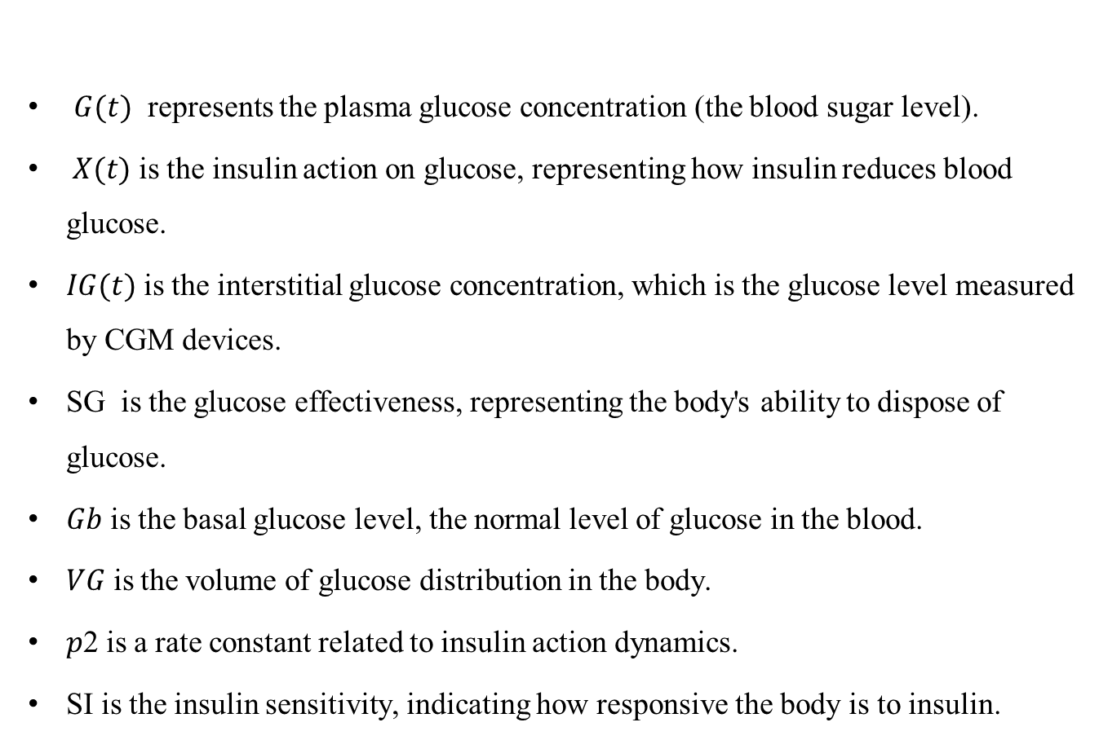
Mepco Schlenk Engineering College (Autonomous)
Problem Definition and Description of Model
$G(t)$ represents the plasma glucose concentration (the blood sugar level).
$X(t)$is the insulin action on glucose, representing how insulin reduces blood glucose.
$IG(t)$is the interstitial glucose concentration, which is the glucose level measured by CGM devices.
SG​ is the glucose effectiveness, representing the body's ability to dispose of glucose.
𝐺𝑏​ is the basal glucose level, the normal level of glucose in the blood.
𝑉𝐺​ is the volume of glucose distribution in the body.
𝑝2 is a rate constant related to insulin action dynamics.
SI is the insulin sensitivity, indicating how responsive the body is to insulin.
Department of Computer Science and Engineering
48

Slide 49

Mepco Schlenk Engineering College (Autonomous)
Problem Definition and Description of Model
$Ipb$is the basal (normal) insulin level in the plasma.
𝛼 is the delay factor between plasma glucose and interstitial glucose.
𝜌(𝐺) is a function that increases insulin action when glucose levels are low, allowing the model to capture the stronger effect of insulin during hypoglycemia.
Department of Computer Science and Engineering
49

Slide 50
Mepco Schlenk Engineering College (Autonomous)
Problem Definition and Description of Model
Black-Box Model Module
Description: This module encompasses several advanced deep learning algorithms designed to capture complex patterns in the data. The specific models implemented include:
Algorithm:
Long Short-Term Memory (LSTM):
A type of recurrent neural network (RNN) designed to learn and remember over long sequences.
designed to handle sequential data (like time series).
use a special structure with memory cells that allow to
Remember important information for a long time
Forget less relevant information when needed
Department of Computer Science and Engineering
50

Slide 51
Mepco Schlenk Engineering College (Autonomous)
Problem Definition and Description of Model
Takes the input as Historical BG levels, meal intake, and insulin doses
Predict the BG levels for a given time in the future.
Gated Recurrent Units (GRU)
simplifies the architecture while maintaining performance in sequential data tasks
similar to LSTM, but with a simpler architecture.
fewer parameters compared to LSTM, making it computationally more efficient.
uses two gates
Update Gate: Determines how much past information to be continue to carry forward
Reset Gate: Determines how much of the past information to forget.
Department of Computer Science and Engineering
51

Slide 52
Mepco Schlenk Engineering College (Autonomous)
Problem Definition and Description of Model
Takes the input as Historical BG levels, meal intake, and insulin doses were fed into a single hidden layer with 35 GRU units
Predicted the BG over 60 minutes, generating consecutive future BG values.
Temporal Convolutional Network (TCN)
Type of Convolutional Networks designed to handle sequential data, utilizing convolutional layers
Use convolution layers to process time-series data
TCNs use
Causal Convolutions : Predictions are determined only by past data.
Dilated Convolutions: expands the receptive field to capture long-term dependencies efficiently
Department of Computer Science and Engineering
52

Slide 53
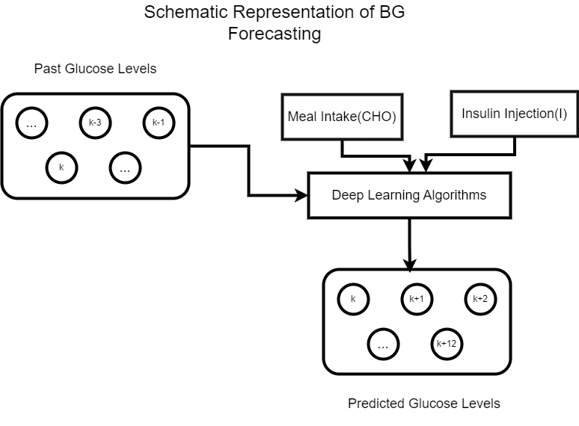
Mepco Schlenk Engineering College (Autonomous)
Problem Definition and Description of Model
SCHEMATIC REPRESENTATION OF BG FORECASTING WITH
LSTM,GRU AND TCN
Department of Computer Science and Engineering
53

Slide 54
Mepco Schlenk Engineering College (Autonomous)
Problem Definition and Description of Model
Techniques:
Models trained on historical data with hyperparameter tuning predict future blood glucose levels, capturing varying postprandial responses.
Model Training: Use Keras in Python to implement and train LSTM, GRU,
and TCN models.
Department of Computer Science and Engineering
54

Slide 55

Mepco Schlenk Engineering College (Autonomous)
HbA1c Calculation
1. Predict future blood glucose levels for better diabetes management.
2. Serves as a long-term indicator to guide and validate predictions.
3. Enhances accuracy by combining short-term trends with long-term control.
HbA1c = $\frac{eAG\left(\frac{mg}{dL}\right)+46.7}{28.7}$
. $eAG\left(\frac{mg}{dl}\right)$ - estimated Average Glucose over period of time(mg/dL)
Problem Definition and Description of Model
Department of Computer Science and Engineering
55

Slide 56
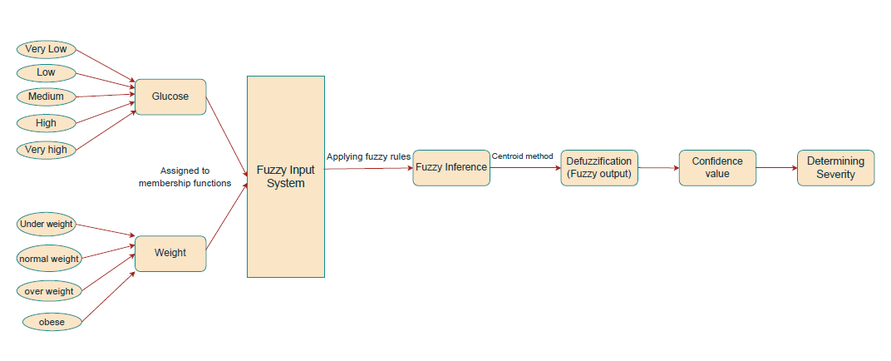
Mepco Schlenk Engineering College (Autonomous)
Fuzzy Logic-Based Diabetes Severity Prediction
Problem Definition and Description of Model
Department of Computer Science and Engineering
56

Slide 57
Mepco Schlenk Engineering College (Autonomous)
Fuzzy Logic-Based Diabetes Severity Prediction
1. Used for classifying diabetes severity based on glucose level & weight.
2. Allows a smooth transition between severity levels.
Key Components
Inputs:
1. Glucose Level (mg/dL): Very Low, Low, Medium, High, Very High
2. Weight (kg): Underweight, Normal, Overweight, Obese
Output:
1. Prediction : Probability of having diabetes (yes or no) .
2. Severity Levels: Very Low, Low, Medium, High, Very High.
Methodology:
20 fuzzy rules based on the relationship between glucose, weight & diabetes severity.
Problem Definition and Description of Model
Department of Computer Science and Engineering
57

Slide 58
Mepco Schlenk Engineering College (Autonomous)
Membership Functions
Glucose
(Glucose = Very Low) → Trapezoidal function (0, 53, 61.5, 97.5)
(Glucose = Low) → Triangular function (53, 83.75, 125)
(Glucose = Medium) → Triangular function (70, 111.25, 162.5)
(Glucose = High) → Triangular function (97.5, 143.75, 200)
(Glucose = Very high) → Trapezoidal function (125, 181.25,200,300)
Weight
(Weight = Under weight) → Trapezoidal function (0, 0, 50, 60)
(Weight = normal weight) → Triangular function (50, 60,80)
(Weight = over weight) → Triangular function (70,80,100)
(Weight = obese) → Trapezoidal function (90, 100, 150, 150)
Problem Definition and Description of Model
Department of Computer Science and Engineering
58

Slide 59
Mepco Schlenk Engineering College (Autonomous)
Triangular membership function
1. Defined by three points forming a triangle
2. Simple and computationally efficient.
3. Used to represent fuzzy sets where the membership value increases linearly to a peak and then decreases linearly.
Trapezoidal membership function
1. Defined by four points forming a trapezoid.
2. Useful when the membership should be at its maximum over a range of values, not just a single point.
Defuzzification (Centroid method)
1. Converts a fuzzy set into a single crisp value.
2. essential for making a final decision or output from the fuzzy inference system.
Problem Definition and Description of Model
Department of Computer Science and Engineering
59

Slide 60
Mepco Schlenk Engineering College (Autonomous)
Fuzzy Rule-Based System
1. Applies 20 rules based on glucose & weight .
2. Some of the rules are
1. If (Glucose = Very Low) AND (Weight = Normal) → Diabetes = No
2. If (Glucose = High) AND (Weight = Overweight) → Diabetes = Yes
3. If (Glucose = Very High) AND (Weight = Obese) → Diabetes = Yes (High Severity)
Severity Classification Criteria
1. Confidence > 0.9 → Very High Severity
Problem Definition and Description of Model
Department of Computer Science and Engineering
60

Slide 61
Mepco Schlenk Engineering College (Autonomous)
Problem Definition and Description of Model
Severity Classification Criteria
2. Confidence > 0.7 → High Severity
3. Confidence > 0.5 → Medium Severity
4. Confidence > 0.3 → Low Severity
5. Confidence ≤ 0.3 → Very Low Severity
These are Calculated using the fuzzy output (confidence value).
Department of Computer Science and Engineering
61

Slide 62
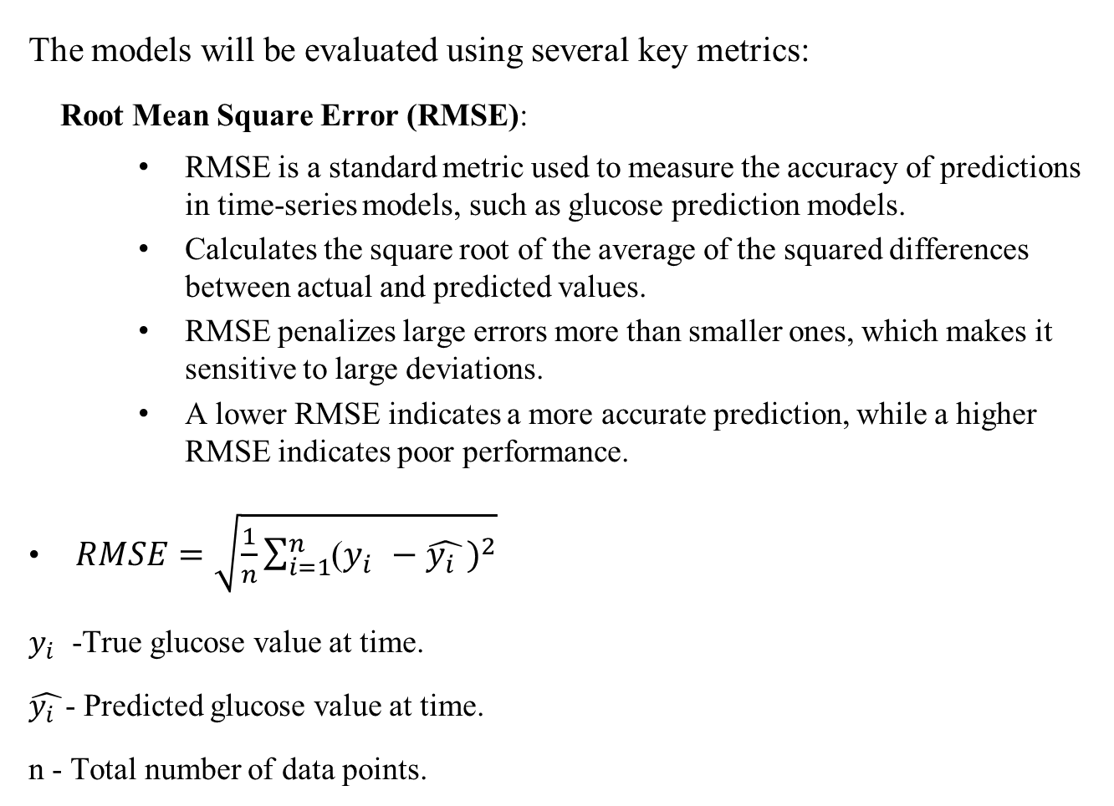
Mepco Schlenk Engineering College (Autonomous)
Evaluation Metrices
The models will be evaluated using several key metrics:
Root Mean Square Error (RMSE):
RMSE is a standard metric used to measure the accuracy of predictions in time-series models, such as glucose prediction models.
Calculates the square root of the average of the squared differences between actual and predicted values.
RMSE penalizes large errors more than smaller ones, which makes it sensitive to large deviations.
A lower RMSE indicates a more accurate prediction, while a higher RMSE indicates poor performance.
$RMSE=\sqrt{\frac{1}{n}\sum_{i=1}^{n}{{\text{(}y_{i }−\hat{y_{i }})}^{2}}}$
$y_{i }$-True glucose value at time.
$\hat{y_{i }}$- Predicted glucose value at time.
n - Total number of data points.
Department of Computer Science and Engineering
62

Slide 63

Mepco Schlenk Engineering College (Autonomous)
Evaluation Metrices
Mean Squared Error (MSE):
MSE measures the average squared difference between actual and predicted values.
It penalizes larger errors more due to squaring.
MSE = $\frac{1}{n}\sum_{i=1}^{n}{{\text{(}y_{i }− \hat{y_{i }})}^{2}}$
where ,
$y_{i }$= actual values
$\hat{y_{i }}$ = predicted values
n = number of observations
Department of Computer Science and Engineering
63

Slide 64

Mepco Schlenk Engineering College (Autonomous)
Evaluation Metrices
Mean Absolute Error (MAE):
MAE calculates the average absolute difference between actual and predicted values.
It gives equal weight to all errors..
MAE = $\frac{1}{n}\sum_{i=1}^{n}{\text{|}y_{i }−\hat{y_{i }}|}$
where ,
$y_{i }$= actual values
$\hat{y_{i }}$= predicted values
n = number of observations
Department of Computer Science and Engineering
64

Slide 65

Mepco Schlenk Engineering College (Autonomous)
Evaluation Metrices
R² Score (Coefficient of Determination):
R² score indicates how well the regression model fits the data..
A value close to 1 means a better fit.
R² = 1 - $\frac{{\text{(}y_{i }−\hat{y_{i }})}^{2}}{{\text{(}y_{i }− \overline{y})}^{2}}$
where ,
$y_{i }$= actual values
$\hat{y_{i }}$= predicted values
$\overline{y }$= mean of actual values
Department of Computer Science and Engineering
65

Slide 66
Mepco Schlenk Engineering College (Autonomous)
Dataset Details
Name:Ohio Type 1 Diabetes Mellitus(https://www.kaggle.com/datasets/ryanmouton/ohiot1dm) (http://smarthealth.cs.ohio.edu/OhioT1DMdataset.html)
Reference:OhioT1DM Dataset, “The OhioT1DM Dataset for Blood Glucose Level Prediction: Update 2020”
Dataset Description:
The dataset contains patient information for Type 1 Diabetes Mellitus, specifically focusing on glucose levels and insulin types. The data is stored in an XML format, providing structured and timestamped glucose readings.
Key Components of the Dataset:
1)Patient Details:
ID(Integer): Unique identifier for each patient (e.g., 559).
Weight(Float/Integer): The weight of the patient in kilograms (e.g., 99).
Insulin Type(String): Type of insulin used by the patient (e.g., Novalog).
2)Glucose Level Readings:
Timestamp (ts)(DateTime): Date and time when the glucose level was recorded (e.g., 18-01-2022 00:01:00).
Value(Double): The recorded glucose level at that specific timestamp (e.g., 179).
Department of Computer Science and Engineering
66

Slide 67
Mepco Schlenk Engineering College (Autonomous)
Dataset Details
3.Finger Stick:Blood glucose values obtained through self-monitoring by the patient.
4. Basal:The basal insulin rate is continuously infused from the specified timestamp 𝑡𝑠​ until a new rate is set.
5. Temp Basal:A temporary basal insulin rate replaces the normal basal rate. A value of 0 indicates suspended insulin flow. At the end of the temp basal, the rate returns to normal.
6. Bolus:Insulin delivered to the patient, typically before meals or during hyperglycemia. The normal bolus delivers all insulin at once, while other types can spread the dose over the period between 𝑡𝑠 begin and 𝑡s​ end.
7. Meal:The self-reported time and type of a meal, plus the patient’s carbohydrate estimate for the meal.
8. Sleep:The times of self-reported sleep, plus the patient’s subjective assessment of sleep quality: 1 for Poor; 2 for Fair; 3 for Good.
Department of Computer Science and Engineering
67

Slide 68
Mepco Schlenk Engineering College (Autonomous)
Working Environment
1.Software Tools:
Data Management and Analysis and Visualization:
Python Programming
Libraries:(NumPy,MatPlotlib,Pandas,Tensorflow)
Integrated Development Environment (IDE):
Jupyter Notebook or Google Colab or Visual Studio Code.
2.Hardware Requirements:
Processor:Intel i5 or Similar
RAM:8GB or more
GPU: NVIDIA GTX 1050 / Intel® Iris® Xe Graphics
Storage: SSD with at least 256 GB of space
3.Environmental Setup:
Operating System:Windows 10/11, macOS, or Linux (e.g., Ubuntu).
Version Control:
GitHub: For managing changes to your code.
Department of Computer Science and Engineering
68

Slide 69
Mepco Schlenk Engineering College (Autonomous)
1.1 Deep Neural Network (LSTM / GRU / TCN)
Input : Set of optimal features X1, X2, …, Xn, Weights (w1, w2, …, wn)
Output : Target Class (Regression Output)
begin
M0 ← set_seq_model() // Sequential model is initialized
If using LSTM: // selecting the deep neural models
M1 ← lstm layer with 30 memory units
Else If using GRU:
M1 ← gru layer with 35 memory units
M2 ← gru layer with another 50 units
Else If using TCN:
M1 ← tcn layer with 64 filters
Pseudo Code(Module Implementation)
Department of Computer Science and Engineering
69

Slide 70
Mepco Schlenk Engineering College (Autonomous)
1.1 Deep Neural Network (LSTM / GRU / TCN)
M2 ← addLayer(M1, Flatten())
Mf ← optimiseLayers(Mf-1, opt, lossfn)
// opt ← Adam Optimizer
// lossfn ← Root Mean Squared Error (RMSE) // as in equation m.1
Xb, Yb ← setBatch()
// Xb ← training input features
// Yb ← target labels
ep ← setEpoch()
// ep ← number of training epochs
For i ← 1 to ep do
OM ← trainModel(Mf, Xb, Yb)
End For
Pseudo Code(Module Implementation)
Department of Computer Science and Engineering
70

Slide 71

Mepco Schlenk Engineering College (Autonomous)
1.1 Deep Neural Network (LSTM / GRU / TCN)
Ypred ← predict(OM, Xtest)
// OM ← trained model
// Xtest ← test input
Metrics_test ← get_Score(Xtest, Ypred)
End
1.2 Adaptive Single Component Metropolis Hastings
Input : Initial parameters $θ_{phy0}$ , number of iterations nIter
Output : Updated parameter $θ_{phy}$ after nIter iterations
i←0
initialize $θ_{phy0}$,nIter
Pseudo Code(Module Implementation)
Department of Computer Science and Engineering
71

Slide 72
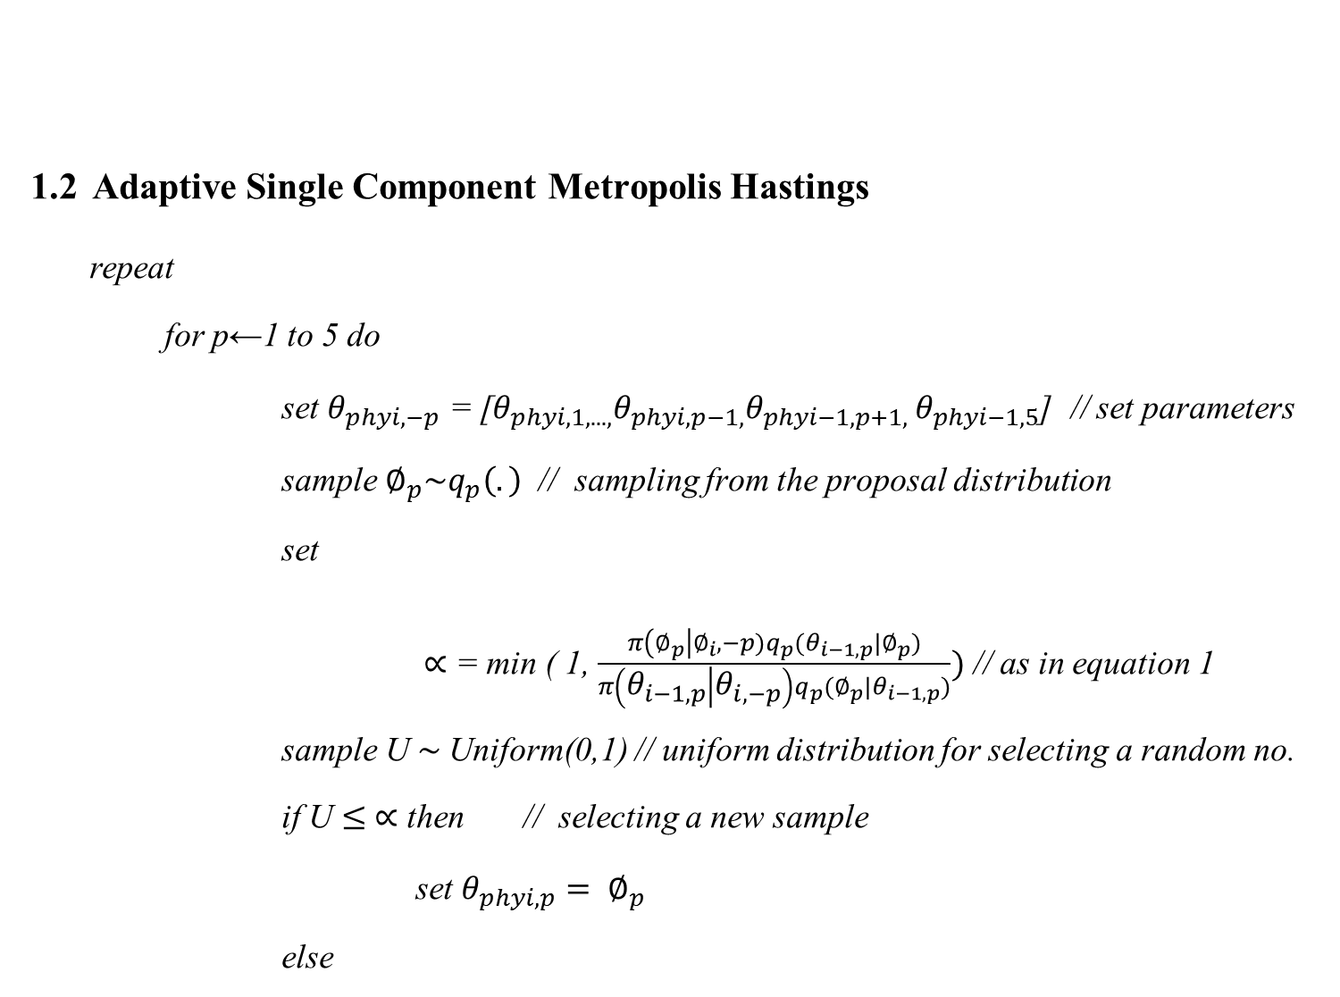
1.2 Adaptive Single Component Metropolis Hastings
repeat
for p←1 to 5 do
set $θ_{phyi,−p}$ = [$θ_{phyi,1,. . .,}θ_{phyi,p−1,}θ_{phyi−1,p+1, }θ_{phyi−1,5}$] // set parameters
sample $∅_{p}\sim q_{p}\left(.\right)$ // sampling from the proposal distribution
set
$∝$ = min ( 1, $\frac{π\left(∅_{p}\right|∅_{i},−p)q_{p}(θ_{i−1,p}|∅_{p})}{π\left(θ_{i−1,p} | θ_{i,−p}\right)q_{p}(∅_{p}|θ_{i−1,p})})$ // as in equation 1
sample U $\sim$Uniform(0,1) // uniform distribution for selecting a random no.
if U $≤$ $∝$ then // selecting a new sample
set $θ_{phyi,p}= ∅_{p}$
else
Mepco Schlenk Engineering College (Autonomous)
Pseudo Code(Module Implementation)
Department of Computer Science and Engineering
72

Slide 73

Mepco Schlenk Engineering College (Autonomous)
Pseudo Code(Module Implementation)
1.2 Adaptive Single Component Metropolis Hastings
set $θ_{phyi,p}=θ_{phyi−1,p}$
end
end
i← i+1
Until n $<$nIter
1.3 Glucose-Insulin Dynamics
Input : Model Parameters (ka2, kd, ke, VI, beta, kgri, kempt, kabs, f, SG, Gb, VG, p2, SI, Ipb,alpha)
Output : Glucose and Insulin Concentration Changes (ΔIsc1, ΔIsc2, ΔIp, ΔQsto1, ΔQsto2, ΔQgut, Ra, ΔG, ΔX, ΔIG)
Department of Computer Science and Engineering
73

Slide 74

Mepco Schlenk Engineering College (Autonomous)
1.3 Glucose-Insulin Dynamics
begin
Initialize parameters P ← {ka2, kd, ke, VI, beta, kgri, kempt, kabs, f, SG, Gb, VG, p2, SI, Ipb, alpha} // model parameters
Function Subcutaneous_Insulin_Absorption(insulin):
Isc1, Isc2, Ip ← insulin['Isc1'], insulin['Isc2'], insulin['Ip’]
$I_{sc1}\text{(}\text{t}\text{)} \text{←} \text{−}k_{d}\text{·}I_{sc1}\text{(}\text{t}\text{) + }\text{I}\text{(}\text{t}\text{ − }\text{β}\text{)/}\text{V}$
${ I}_{sc2}$(t) ← $k_{e}$ · $I_{sc1}$(t) − $k_{a2}$ · $I_{sc2}$(t) // as in equations 2.1 to 2.3
${ I}_{p}$(t) ← $k_{a2}$ · $I_{sc2}$ − $k_{e}$ · $I_{p}$(t)
Return (ΔIsc1, ΔIsc2, ΔIp)
Pseudo Code(Module Implementation)
Department of Computer Science and Engineering
74

Slide 75

Mepco Schlenk Engineering College (Autonomous)
1.3 Glucose-Insulin Dynamics
Function Oral_Glucose_Absorption(CHO):
Qsto1, Qsto2, Qgut ← CHO['Qsto1'], CHO['Qsto2'], CHO['Qgut’]
${ Q}_{sto1}(t) \text{←}−k_{gri}·Q_{sto1}(t) + CHO(t)$
${ Q}_{sto2}\left(t\right) \text{←}{ k}_{gri}·Q_{sto1}(t) −k_{empt}·Q_{sto2}(t)$ // as in equation 3.1 to 3.4
${ Q}_{gut}(t) \text{←} k_{empt}·Q_{sto2}(t) −k_{abs}·Q_{gut}(t)$
$R_{a}(t) \text{←} f ·k_{abs}·Q_{gut}(t)$
Return (ΔQsto1, ΔQsto2, ΔQgut, Ra)
Function Glucose_Insulin_Kinetics(glucose, insulin_action, Ra):
G, X, IG ← glucose['G'], glucose['X'], glucose['IG']
Pseudo Code(Module Implementation)
Department of Computer Science and Engineering
75

Slide 76

1.3 Glucose-Insulin Dynamics
$G\left(t\right) \text{←}−\left[SG + ρ\left(G\right)X\left(t\right)\right]· G\left(t\right)+ SG · Gb +\frac{Ra\left(t\right)}{VG}$
$X\left(t\right) \text{←}−p2 · [X(t) − SI · (Ip(t) − Ipb)]$ // as in equations 4.1 to 4.3
$IG\left(t\right) \text{←}− 1 /α (IG(t) − G(t))$
Return (ΔG, ΔX, ΔIG)
End
1.4 Hybrid Model Integration
Input : White-box Features (W), Black-box Data (B)
Output : Combined Feature Set (C)
begin
If W is a 1D array then // W- whitebox model
Mepco Schlenk Engineering College (Autonomous)
Pseudo Code(Module Implementation)
Department of Computer Science and Engineering
76

Slide 77
Mepco Schlenk Engineering College (Autonomous)
1.4 Hybrid Model Integration
Reshape W to 2D (W ← reshape(W, (-1,1)))
End If
If B is a 1D array Then // B – blackbox model
Reshape B to 2D (B ← reshape(B, (-1,1)))
End If
C ← Concatenate(W, B) along axis=1
// Combining both feature sets into a single input
Return C
End
Pseudo Code(Module Implementation)
Department of Computer Science and Engineering
77

Slide 78

Mepco Schlenk Engineering College (Autonomous)
1.5 PH Optimization using Genetic Algorithm
Input : Parameter bounds param_bounds,Population size pop_size , Number of Generations generations ,Mutation rate mutation_rate
Output: Best individual with optimal parameters
begin
P0 ← initialize_population(pop_size, param_bounds) //initial population is generated
for i ← 1 to generations
F ← evaluate_fitness(Pi-1, data) // compute fitness scores for current population
Si ← tournament_selection(Pi-1, F) // perform tournament selection
Oi ← $∅$ // initialize offspring set
Pseudo Code(Module Implementation)
Department of Computer Science and Engineering
78

Slide 79
Mepco Schlenk Engineering College (Autonomous)
1.5 PH Optimization using Genetic Algorithm
for j ← 1 to pop_size/2 // Perform crossover and mutation
P1, P2 ← random_selection(Si)
C1, C2 ← crossover(P1, P2)
C1 ← mutate(C1, mutation_rate, param_bounds)
C2 ← mutate(C2, mutation_rate, param_bounds)
Oi ← Oi ∪ {C1, C2}
Pi ← Oi // Update population
Best_Individual ← max(Pi, evaluate_fitness) // Return best individual
end
Pseudo Code(Module Implementation)
Department of Computer Science and Engineering
79

Slide 80
Mepco Schlenk Engineering College (Autonomous)
1.5.1 Fitness
begin
fitness_score ← 0 // Initialize fitness score
for each data_point in data:
sum_product ← 0 // Initialize sum of product for each data point
for each param, value in data_point:
// Compute sum of weighted values
sum_product ← sum_product + (params[param] * value)
// Accumulate fitness score
fitness_score ← fitness_score + sum_product
Pseudo Code(Module Implementation)
Department of Computer Science and Engineering
80

Slide 81
Mepco Schlenk Engineering College (Autonomous)
Pseudo Code(Module Implementation)
1.5.1 Fitness
Return fitness_score / len(data) // Return average fitness score
end
1.5.2 Tournament Selection
Begin
selected_population ← ∅ // Initialize selected population
For each individual in population:
// Randomly select k individuals
selected_individuals ← random selection of k individuals from population w with their fitness scores
Department of Computer Science and Engineering
81

Slide 82
Mepco Schlenk Engineering College (Autonomous)
Pseudo Code(Module Implementation)
1.5.2 Tournament Selection
// Select the best individual
best_individual ← the individual with the highest fitness from selected_individuals
// Add the best individual to the selected population
selected_population ← selected_population ∪ {best_individual}
// Return the selected population
Return selected_population
end
Department of Computer Science and Engineering
82

Slide 83
Mepco Schlenk Engineering College (Autonomous)
1.6 Fuzzy Logic-Based Diabetes Severity Prediction
Input: Glucose level G, Weight W, Fuzzy Rule Set R, Defuzzification Method D
Output: Diabetes prediction D, Severity Level S
Begin
FIS ← initialize_fuzzy_inference_system(R, D) // Initialize fuzzy system
// X → Y – Antecedent → Consequent
Rules ← {
(G = Very Low, W = Underweight) → (Prediction = No, Severity = Very Low),
(G = Very Low, W = Normal) → (Prediction = No, Severity = Very Low),
(G = Very Low, W = Overweight) → (Prediction = No, Severity = Very Low),
(G = Very Low, W = Obese) → (Prediction = No, Severity = Very Low),
Pseudo Code(Module Implementation)
Department of Computer Science and Engineering
83

Slide 84
Mepco Schlenk Engineering College (Autonomous)
1.6 Fuzzy Logic-Based Diabetes Severity Prediction
(G = Low, W = Underweight) → (Prediction = No, Severity = Low),
(G = Low, W = Normal) → (Prediction = No, Severity = Low),
(G = Low, W = Overweight) → (Prediction = No, Severity = Low),
(G = Low, W = Obese) → (Prediction = No, Severity = Low),
(G = Medium, W = Underweight) → (Prediction = No, Severity = Medium),
(G = Medium, W = Normal) → (Prediction = No, Severity = Medium),
(G = Medium, W = Overweight) → (Prediction = No, Severity = Medium),
(G = Medium, W = Obese) → (Prediction = No, Severity = Medium),
Pseudo Code(Module Implementation)
Department of Computer Science and Engineering
84

Slide 85
Mepco Schlenk Engineering College (Autonomous)
1.6 Fuzzy Logic-Based Diabetes Severity Prediction
(G = High, W = Underweight) → (Prediction = No, Severity = High),
(G = High, W = Normal) → (Prediction = No, Severity = High),
(G = High, W = Overweight) → (Prediction = Yes, Severity = High),
(G = High, W = Obese) → (Prediction = Yes, Severity = High),
(G = Very High, W = Underweight) → (Prediction = Yes, Severity = Very High),
(G = Very High, W = Normal) → (Prediction = Yes, Severity = Very High),
(G = Very High, W = Overweight) → (Prediction = Yes, Severity = Very High),
(G = Very High, W = Obese) → (Prediction = Yes, Severity = Very High) }
Pseudo Code(Module Implementation)
Department of Computer Science and Engineering
85

Slide 86
Mepco Schlenk Engineering College (Autonomous)
1.6 Fuzzy Logic-Based Diabetes Severity Prediction
Assign I/P (“g”)= G // Assigning inputs glucose and weights to fuzzy system
Assign I/P (“w”)= W
M = FIS model(G,W)
C = M.predict() // Compute fuzzy output
If C > 0.5 then return "Has Diabetes" // Final Diabetes Prediction
Else return "No Diabetes“
Pseudo Code(Module Implementation)
Department of Computer Science and Engineering
86

Slide 87
Mepco Schlenk Engineering College (Autonomous)
Pseudo Code(Module Implementation)
1.6 Fuzzy Logic-Based Diabetes Severity Prediction
If C > 0.9 then return "Very High" // Determine Severity Level
Else if C > 0.7 then return "High"
Else if C > 0.5 then return "Medium"
Else if C > 0.3 then return "Low"
Else return "Very Low"
end
Department of Computer Science and Engineering
87

Slide 88

Mepco Schlenk Engineering College (Autonomous)
Reviewer Comments and Responses
Comments
1. Check the Evaluation metrics used.
2. System Diagram is not clear and visible and need to visualize the evaluation metrics.
Responses
1. Changed the evaluation metrics to RMSE, MSE, MAE, $R^{2}$ Score.
2. Split the diagram into smaller parts for better clarity and visibility and reconstructed the diagram also.
3. Included the K-Fold cross validation to generalize the model.
4. Included the Evaluation metrics results as bar chart for better visualization.
Department of Computer Science and Engineering
88

Slide 89
Mepco Schlenk Engineering College (Autonomous)
OUTPUT
Estimating parameters using Adaptive SCMH
Iterations | Parameters | Current Value | Proposed Value
0 | ka2 | 0.02 | 0.0268
0 | ke | 0.03 | 0.1028
0 | VI | 0.01 | 0.0009
0 | beta | 8 | 8.005
0 | kgri | 0.1 | 0.0586
Department of Computer Science and Engineering
89

Slide 90
Mepco Schlenk Engineering College (Autonomous)
OUTPUT
Estimating parameters using Adaptive SCMH Contd…
Iterations | Parameters | Current Value | Proposed Value
0 | kempt | 0.05 | 0.1169
0 | kabs | 0.07 | 0.0124
0 | f | 0.9 | 0.7118
0 | Gb | 100 | 99.8675
0 | VG | 1.45 | 1.5147
0 | SI | 0.002 | 0.0056
Department of Computer Science and Engineering
90

Slide 91
Mepco Schlenk Engineering College (Autonomous)
OUTPUT
Estimating parameters using Adaptive SCMH Contd…
Iterations | Parameters | Current Value | Proposed Value
0 | Ipb | 15 | 15.0794
0 | alpha | 0.1 | 0.2279
1 | kd | 0.03 | 0.1328
1 | VI | 0.126 | 0.0201
1 | beta | 8 | 7.8444
1 | kgri | 0.1 | 0.0906
Department of Computer Science and Engineering
91

Slide 92
Mepco Schlenk Engineering College (Autonomous)
OUTPUT
Estimating parameters using Adaptive SCMH contd…
Iterations | Parameters | Current Value | Proposed Value
1 | kempt | 0.05 | 0.0980
1 | kabs | 0.07 | 0.0391
1 | f | 0.9 | 0.8987
1 | Gb | 100 | 100.1554
1 | VG | 1.45 | 1.4755
Department of Computer Science and Engineering
92

Slide 93
Mepco Schlenk Engineering College (Autonomous)
OUTPUT
Estimating parameters using Adaptive SCMH contd…
Iterations | Parameters | Current Value | Proposed Value
1 | SI | 0.002 | 0.0437
1 | Ipb | 15 | 15.0709
1 | alpha | 0.1 | 0.1713
Department of Computer Science and Engineering
93

Slide 94
Mepco Schlenk Engineering College (Autonomous)
OUTPUT
LSTM
PH Time Horizon | 34 minutes | 43 minutes | 12 minutes
RMSE | 2.2060 | 1.2980 | 0.9682
MSE | 4.8668 | 1.6850 | 0.9374
MAE | 1.4132 | 1.1560 | 0.8398
R² Score | 0.9988 | 0.9995 | 0.9997
Department of Computer Science and Engineering
94

Slide 95
Mepco Schlenk Engineering College (Autonomous)
OUTPUT
GRU
PH Time Horizon | 34 minutes | 43 minutes | 12 minutes
RMSE | 0.9023 | 1.6950 | 1.0284
MSE | 0.8141 | 2.8731 | 1.0577
MAE | 0.4409 | 1.4051 | 0.7109
R² Score | 0.9998 | 0.9993 | 0.9997
Department of Computer Science and Engineering
95

Slide 96
Mepco Schlenk Engineering College (Autonomous)
OUTPUT
TCN
PH Time Horizon | 34 minutes | 43 minutes | 12 minutes
RMSE | 0.8890 | 1.1337 | 0.8376
MSE | 0.7903 | 1.2853 | 0.7015
MAE | 0.4928 | 0.9131 | 0.4705
R² Score | 0.9998 | 0.9996 | 0.9998
Department of Computer Science and Engineering
96

Slide 97
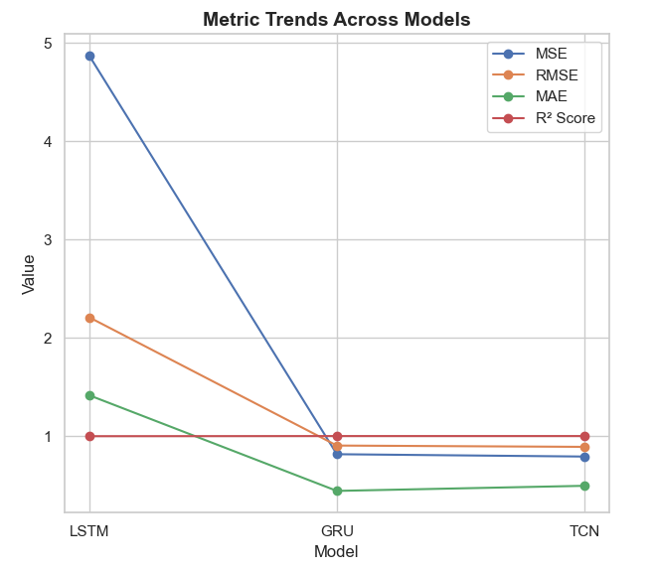
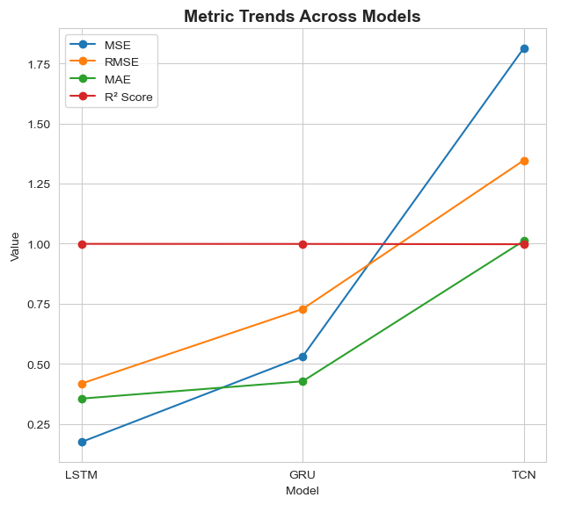
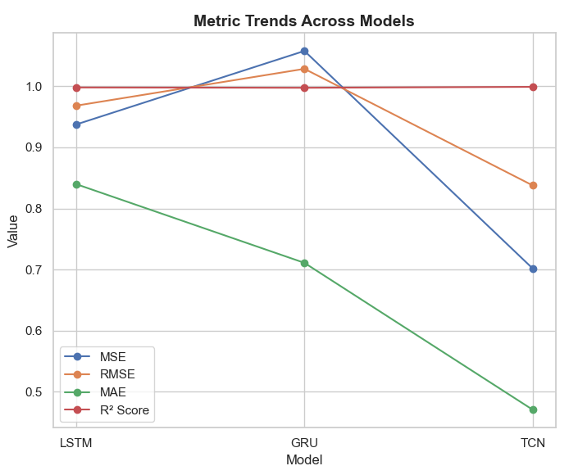
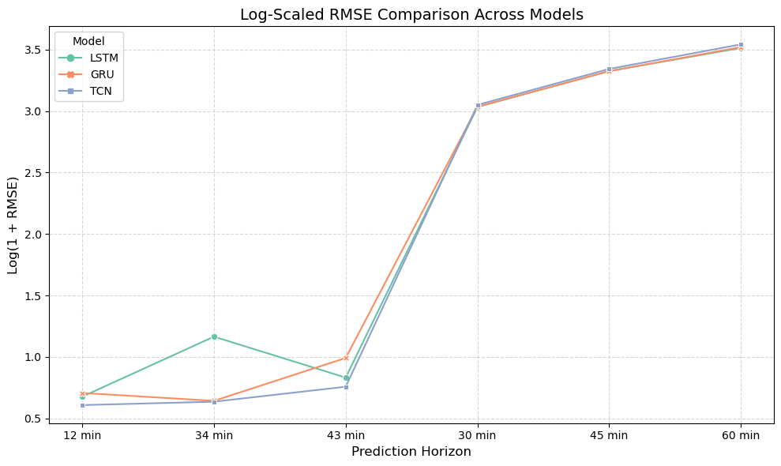
Mepco Schlenk Engineering College (Autonomous)
OUTPUT
Department of Computer Science and Engineering
97

Slide 98
Mepco Schlenk Engineering College (Autonomous)
OUTPUT
HbA1c Prediction
Patient id | Mean Glucose values | Predicted HbA1c
540 | 132.60 | 6.25%
544 | 160.18 | 7.21%
552 | 139.65 | 6.49%
567 | 147.31 | 6.76%
584 | 186.77 | 8.13%
596 | 141.50 | 6.56%
Department of Computer Science and Engineering
98

Slide 99
Mepco Schlenk Engineering College (Autonomous)
SAMPLE OUTPUT
Fuzzy Rule-Based Severity Classification
Glucose values (mg/dl) | Confidence value | Severity Level
76.0 | 0.28 | Very Low
110.0 | 0.60 | Medium
205.0 | 0.63 | High
252.0 | 0.63 | Very high
100.0 | 0.30 | Low
Department of Computer Science and Engineering
99

Slide 100
Mepco Schlenk Engineering College (Autonomous)
Social Impacts
Helps individuals with type-1 diabetes manage their glucose levels effectively.
Helps in reducing the risks over hyperglycemia and hypoglycemia.
Reduces the need for frequent manual glucose monitoring.
Provides real-time prediction of blood glucose levels
Enables individualized predictive insights, improving accuracy.
Can be integrated with Continuous glucose monitoring systems.
Department of Computer Science and Engineering
100

Slide 101
Mepco Schlenk Engineering College (Autonomous)
Economic Aspects
Lowers Hospitalizations due to diabetes-related complications.
Reduces cost associated with Medical interventions.
Helps diabetes patients to maintain stable glucose levels reducing the risks.
Encourages a better innovations based on AI for diabetic related diseases.
Department of Computer Science and Engineering
101

Slide 102
Mepco Schlenk Engineering College (Autonomous)
REFERENCES
Base Paper:
1.Giacomo Cappon , Francesco Prendin , Andrea Facchinetti , Giovanni Sparacino and Simone Del Favero, “Individualized Models for Glucose Prediction in Type 1 Diabetes: Comparing Black-Box Approaches to a Physiological White-Box One”, IEEE TRANSACTIONS ON BIOMEDICAL ENGINEERING, VOL. 70, NO. 11, NOVEMBER 2023.
References:
1. Cindy Marling1, Razvan Bunescu1, “The OhioT1DM Dataset for Blood Glucose Level Prediction Update 2020”, EUR Workshop Proc. 2020 September ; 2675: 71–74
Department of Computer Science and Engineering
102

Slide 103
Mepco Schlenk Engineering College (Autonomous)
REFERENCES
2. Mario Munoz-Organero, “Deep physiological model for blood glucose prediction in T1DM patients”, Sensors 2020, 20,3896.
3. Ganjar Alfian , Muhammad Syafrudin , Muhammad Anshari, “Blood glucose prediction model for type 1 diabetes based on artificial neural network with time-domain features”, biocybernetics and biomedical engineering 40(2020) 1586 – 1599
4. Jobeda Jamal Khanam, Simon Y. Foo, “A comparison of machine learning algorithms for diabetes prediction”, ICT Express 7 (2021) 432-439.
Department of Computer Science and Engineering
103

Slide 104
Mepco Schlenk Engineering College (Autonomous)
REFERENCES
5. Jobeda Jamal Khanam, Simon Y. Foo, “A comparison of machine learning algorithms for diabetes prediction”, ICT Express 7 (2021) 432-439.
6. Wonju Seoa, Sung-Woon Park , Namho Kima, Sang-Man Jinc, Sung-Min Parka, “A personalized blood glucose level prediction model with a fine-tuning strategy: A proof-of-concept study”, Computer Methods and Programs in Biomedicine 211 (2021) 106424.
7. Hatice Vildan Dudukcu, Murat Taskiran, Tulay Yildirim, “Blood glucose prediction with deep neural networks using weighted decision level fusion”, biocybernetics and biomedical engineering 41 (2021) 1208– 1223.
Department of Computer Science and Engineering
104

Slide 105
Mepco Schlenk Engineering College (Autonomous)
REFERENCES
8. . Hatice Vildan Dudukcu, Murat Taskiran, Tulay Yildirim, “Blood glucose prediction with deep neural networks using weighted decision level fusion”, biocybernetics and biomedical engineering 41 (2021) 1208– 1223.
9. Gangani Dharmarathne, Thilini N. Jayasinghe, Madhusha Bogahawaththa, D.P.P. Meddage, Upaka Rathnayake, “A novel machine learning approach for diagnosing diabetes with a self-explainable interface”, Healthcare Analysis, (2024) 100301.
10. Sean Pikulin, Irad Yehezkel, Robert Moskovitch,“Enhanced blood glucose levels prediction with a smartwatch”, PLoS ONE 19(7) (2024).
Department of Computer Science and Engineering
105

Slide 106
Mepco Schlenk Engineering College (Autonomous)
THANK YOU
Department of Computer Science and Engineering
106

